Slide 1
FIN 40153: Advanced Corporate Finance
CAPITAL STRUCTURE
(BASED ON RWJ CHAPTERS 16 & 17)

Slide 2
The Capital Structure Choice
How should companies finance their operations?
What types of firms should rely heavily on debt financing, and when is equity financing preferred?
Does a particular mix of debt/equity result in a higher (or lower) firm value than other possible combinations?
Is there an optimal mix of debt and equity that results in the highest possible firm value?
Do our investment activities depend upon our financing policies?

Slide 3
What Does Financing Look Like?
Firm Size
Information
Very small, no track record
Small with growth potential
Medium-sized
Large with Track record
Self
Inside seed money
Short Debt
Short-term commercial loans
Commercial paper
Inter-
mediate
Debt
Intermediate-term commercial loans
Medium-term
Notes
Long-Term
Debt
Mezzanine Finance
Private Placements
Bonds
Outsider Equity
Venture Capital
Public Equity

Slide 4
What is Different Between Debt and Equity?
Debt
Equity
Fixed Promised payments
Senior to equity
Interest is deductible
Only get control rights in default
Uncertain residual cash flows
Subordinated to debt
Dividends are not deductible
Comes with control rights (can vote)

Slide 5
Capital Structure: How should a firm structure the liability side of the balance sheet?
Debt vs. Equity
We have seen how to calculate the cost of capital when a firm has debt and equity.
However, we have not figured out how much debt the firm should have.
Can the firm create value for shareholders through its financing decisions?
In particular, should the firm load up with ‘low cost’ debt?

Slide 6
Illustration of MM's Proposition I
Physical Assets = $50,000 Cash = $0
Shares Outstanding = 10,000 Debt (B - Bonds) = $0
Expected EBIT = $5,000/yr Equity (S - Stock) = $50,000
Expected return on assets (r_{A}) = 10%
or Cost of Capital for an all equity firm
Thus, the price of the firm's shares is $5.00 ($50,000 / 10,000)
Balance Sheet (Market Value)
Cash = $0 Debt = $0
Fixed Assets = $50,000 Equity = $50,000
______________________________________________________________
Total Assets $50,000 Total liabilities $50,000
Value of fixed assets = c/r = $5,000/0.1 = $50,000

Slide 7
This firm is going to change is capital structure to one where it has 50% debt and 50% equity. Cost of debt (r_{D})= 5%.
Issue Bonds = $25,000
Note that this is a pure capital structure change - nothing else is altered.
After Recapitalization
Cash = $25,000 Debt = $25,000
Fixed = $50,000 Equity = $50,000
Assets
______________________________________________________________
Total Assets $75,000 Total liabilities $75,000

Slide 8
Next, the stockholders pay out the cash as a dividend.
Issue the Bonds = $25,000 and Pay Dividend = $25,000
Again this is a pure capital structure change - nothing else is altered.
After Recapitalization
Cash = $0 Debt = $25,000
Fixed = $50,000 Equity = $25,000
Assets
______________________________________________________________
Total Assets $50,000 Total liabilities $50,000
The value of the firm is unchanged at $50,000. The wealth of the stockholders is also unchanged at $5.00 per share; $2.50 in dividend + 2.50 in new share price. New share price computed as 25,000 divided by 10,000.

Slide 9
Logic Behind MM Proposition I
A firm produces an annual cash flow of $EBIT. If the discount rate for these cash flows is r_{A}, then the expected value of the firm (assuming perpetual cash flows) is:
V = EBIT / r_{A}
where r_{A} is the expected return on assets or the expected return on equity r_{E} for an all-equity firm.
The level of debt affects only the liabilities side of the firm. Because capital structure has no effect on the assets of a firm, EBIT and r_{A} are unaffected. Therefore, firm value is unaffected by pure capital structure changes. Let U=no debt, L=with debt
MM Proposition I (no taxes) : V_{L} = V_{U} = EBIT / r_{A}

Slide 10
What Happens to the WACC?
One answer is that it makes no difference.
Suppose that there are no taxes (plus other stuff), and that the firm’s operating cash flows are unaffected by how it finances.
Modigliani and Miller won the Nobel Prize for showing:
The value of a firm with debt is in this case equal to the value of the same firm without debt.
The key to this is that they showed that the expected return on equity rises with leverage according to: (L = leverage ratio -- market value of debt over market value of equity, and r denotes expected return).

Slide 11
MM More Formally
The WACC for a firm is constant
and
r_{Equity} = r_{Assets} + (B/S)(r_{Assets}- r_{B})
The capital structure decision is irrelevant
V_{U} = V_{L} = EBIT/r_{SU}, where R_{SU} is the cost of capital in an all equity firm. Notice it will just be WACC (r_{Assets})

Slide 12
WACC under MM Proposition I
Let the expected return on the underlying assets be 9% and the
cost of debt be 6%.
With no taxes the WACC is the same regardless of leverage!
Since we assumed that operating cash flows were also unaffected,
firm value is unaffected by leverage!

Slide 13
What about tax deductions for interest?
Interest is tax deductible (dividends are not).
This creates a valuable debt tax shield.
Modigliani and Miller also showed that if the only change in their analysis is the presence of taxes, then:
The value of a levered firm is:
the value of an equivalent unlevered firm +
the value of the tax shields from debt.
Firm Value always rises with borrowing!

Slide 14
The Interest Tax Deduction (cont'd)
Consider Safeway, Inc. which had earnings before interest and taxes of approximately $1.25 billion in 2005, and interest expenses of about $400 million. Safeway’s marginal corporate tax rate was 35%.
As shown on the next slide, Safeway’s net income in 2005 was lower with leverage than it would have been without leverage.

Slide 15
Safeway (continued)
Safeway’s Income with and without Leverage 2005 ($millions)
 | With Leverage | Without Leverage
EBIT | $1,250 | $1,250
Interest Expense | -400 | 0
Income Before Tax | 850 | 1,250
Taxes (35%) | -298 | -438
Net Income | $552 | $812

Slide 16
The Interest Tax Deduction (cont'd)
Safeway’s debt obligations reduced the value of its equity. But the total amount available to all investors was higher with leverage.
Where does the additional $140 million come from?

Slide 17
The Interest Tax Deduction (cont'd)
Interest Tax Shield
The reduction in taxes paid due to the tax deductibility of interest
In Safeway’s case, the gain is equal to the reduction in taxes with leverage: $438 million − $298 million = $140 million. The interest payments provided a tax savings of 35% × $400 million = $140 million.

Slide 18
The Interest Tax Shield and Firm Value
When a firm uses debt, the interest tax shield provides a corporate tax benefit each year.
This benefit is computed as the present value of the stream of future interest tax shields the firm will receive.
The cash flows a levered firm pays to investors will be higher than they would be without leverage by the amount of the interest tax shield.

Slide 19
The Interest Tax Shield and Firm Value (cont'd)
MM Proposition I with Taxes
The total value of the levered firm exceeds the value of the firm without leverage due to the present value of the tax savings from debt.

Slide 20
MM Proposition I (Corporate Taxes)
Value of firm with leverage = Value if all equity financed + PV interest tax shield
If the debt issued is permanent:
Value of firm with leverage = Value if all equity financed + PV interest tax shield
Weighted Average Cost of Capital (Corporate Taxes)

Slide 21
Illustration of MM's Proposition I with Taxes
Physical Assets = $50,000 Cash = $0
Shares Outstanding = 10,000 Debt (B - Bonds) = $0
Expected EBIT = $5,000/yr Equity (S - Stock) = $50,000
Expected return on assets (r_{A}) = 10% Tax Rate = 40%
or Cost of Capital for an all equity firm
Thus, the price of the firm's shares is $3.00 ($30,000 / 10,000)
Balance Sheet (Market Value)
Cash = $0 Debt = $0
Tax Shields = $0
Fixed Assets = $30,000 Equity = $30,000
______________________________________________________________
Total Assets $30,000 Total liabilities $30,000
Value of fixed assets = c/r = $5000*(1-0.4)/0.1 = $30000

Slide 22
This firm is going to change is capital structure to one where it has $25, 000 in debt. Cost of debt (r_{D})= 5%.
Issue Bonds = $25,000 and Pay Dividend = $25,000
Note that this is a pure capital structure change - nothing else is altered.
After Recapitalization
Cash = $0 Debt = $25,000
Tax Shield = $10,000
Fixed = $30,000 Equity = $15,000
Assets
______________________________________________________________
Total Assets $40,000 Total liabilities $40,000
The value of the firm is now $40,000. The wealth of the stockholders is increased to $4.00 per share; $2.50 in dividend + 1.50 in new share price. New share price computed as $15,000/10,000. The shareholders capture the increased value from leverage.

Slide 23
Recapitalizing to Capture the Tax Shield
Assume that Midco Industries wants to boost its stock price. The company currently has 20 million shares outstanding with a market price of $15 per share and no debt. Midco has had consistently stable earnings, and pays a 35% tax rate. Management plans to borrow $100 million on a permanent basis and they will use the borrowed funds to repurchase outstanding shares.

Slide 24
The Tax Benefit
Without leverage
V^{U} = (20 million shares) × ($15/share) = $300 million
If Midco borrows $100 million using permanent debt, the present value of the firm’s future tax savings is
PV(interest tax shield) = T_{C}×D = 35% × $100 million = $35 million

Slide 25
The Tax Benefit (cont'd)
Thus the total value of the levered firm will be
V^{L} = V^{U} + T_{C}×D = $300 million + $35 million = $335 million
Because the value of the debt is $100 million, the value of the equity is
E = V^{L} − D = $335 million − $100 million = $235 million

Slide 26
The Tax Benefit (cont'd)
Although the value of the shares outstanding drops to $235 million, shareholders will also receive the $100 million that Midco will pay out through the share repurchase.
In total, they will receive the full $335 million, a gain of $35 million over the value of their shares without leverage.

Slide 27
The Share Repurchase
Assume Midco repurchases its shares at the current price of $15/share. The firm will repurchase 6.67 million shares.
$100 million ÷ $15/share = 6.67 million shares
It will then have 13.33 million shares outstanding.
20 million − 6.67 million = 13.33 million

Slide 28
The Share Repurchase (cont'd)
The total value of equity is $235 million; therefore the new share price is $17.625/share.
$235 million ÷ 13.33 million shares = $17.625
Shareholders that keep their shares earn a capital gain of $2.625 per share.
$17.625 − $15 = $2.625

Slide 29
The Share Repurchase (cont'd)
The total gain to shareholders is $35 million.
$2.625/share × 13.33 million shares = $35 million
If the shares are worth $17.625/share after the repurchase, why would shareholders tender their shares to Midco at $15/share?

Slide 30
No Arbitrage Pricing
If investors could buy shares for $15 immediately before the repurchase, and they could sell these shares immediately afterward at a higher price, this would represent an arbitrage opportunity.
Realistically, the value of the Midco’s equity will rise immediately from $300 million to $335 million after the repurchase announcement. With 20 million shares outstanding, the share price will rise to $16.75 per share.
$335 million ÷ 20 million shares = $16.75 per share

Slide 31
No Arbitrage Pricing (cont'd)
With a repurchase price of $16.75, the shareholders who tender their shares and the shareholders who hold their shares both gain $1.75 per share as a result of the transaction.
$16.75 − $15 = $1.75

Slide 32
No Arbitrage Pricing (cont'd)
The benefit of the interest tax shield goes to all 20 million of the original shares outstanding for a total benefit of $35 million.
$1.75/share × 20 million shares = $35 million
When securities are fairly priced, the original shareholders of a firm capture the full benefit of the interest tax shield from an increase in leverage.

Slide 33
Analyzing the Recap: The Market Value Balance Sheet
In the presence of corporate taxes, we must include the interest tax shield as one of the firm’s assets.
We have assumed that the firm receives the entire benefit of the tax shields (we assume the firm is always profitable).
With more uncertain earnings, the firm’s effective tax rate may be less than the maximum statutory rate.

Slide 34
Midco Recapitalization
Market Value Balance Sheet for the Steps in Midco’s Leverage Recapitalization
Market Value Balance Sheet ($ million) | Initial | Step 1: Recap Announced | Set 2: Debt Issuance | Step 3: Share Repurchase
Assets Cash Original Assets (V^{U}) Interest tax shield | 0 300 0 | 0 300 35 | 100 300 35 | 0 300 35
Total Assets Liabilities Debt | 300 0 | 335 0 | 435 100 | 335 100
Equity = Assets-Liabilities |  | 335 | 335 | 235
Shares outstanding (million) | 20 | 20 | 20 | 14.03
Price per share | $15.00 | $16.75 | $16.75 | $16.75

Slide 35
MM with Corporate Taxes
where the cost of equity capital in a levered firm is,
r_{SL} = r_{Assets} + (r_{Assets} - r_{B})(1 - T_{C})(B/S)
with
r_{SU} = the cost of equity capital in an identical unlevered firm (r_{Assets})
r_{B} = the cost of debt capital (We will assume debt is riskless)

Slide 36
Limits to The Use of Debt
Given the treatment the U. S. corporate tax code gives to interest payments versus dividend payments, firms have a big incentive to use debt financing.
Under the MM assumptions with corporate taxes the argument goes to extremes and the message becomes: firms should use 100% debt financing.
What other costs are associated with the use of debt?
Bankruptcy costs and/or financial distress costs!

Slide 37
Bankruptcy Costs
Direct costs:
Legal fees
Accounting fees
Costs associated with a trial (expert witnesses)
Indirect costs:
Reduced effectiveness in the market.
Lower value of service contracts, warranties. Decreased willingness of suppliers to provide trade credit (e.g., Pennzoil v. Texaco).
Loss of value of intangible assets--e.g., patents.

Slide 38
Agency costs of debt
When bankruptcy is possible incentives may be affected.
Example (Risk Shifting):
Big Trouble Corp. (BTC) owes its creditors $5 million, due in six months.
BTC has liquidated its assets because it could not operate profitably. Its remaining asset is $1 million cash.
Big Bill, the lone shareholder and general manager is considering two possible investments.
(1) Buy six month T-bills to earn 3% interest.
(2) Go to Vegas and wager the entire $1 million on a single spin of the roulette wheel.
Why might Bill consider the second “investment”?
Would he have considered it in the absence of leverage?

Slide 39
Agency Costs and the Value of Leverage
Leverage can encourage managers and shareholders to act in ways that reduce firm value.
It appears that the equity holders benefit at the expense of the debt holders.
However, ultimately, it is the shareholders of the firm who bear these agency costs.

Slide 40
Agency Costs and the Value of Leverage (cont'd)
When a firm adds leverage to its capital structure, the decision has two effects on the share price.
The debt holders recognize this possibility and pay less for the debt when it is issued, reducing the amount the firm can distribute to shareholders.
Debt holders lose more than shareholders gain from these activities and the net effect is a reduction in the initial share price of the firm.

Slide 41
A Theory of Capital Structure
The value of the levered firm can be thought of as:
value of equivalent unlevered firm
+
present value of tax shields
-
present value of bankruptcy and agency costs.

Slide 42
The Value of the Firm with Costs of Financial Distress
Value of firm (V) V_{L} = V_{U} +T_{C} B = Value of firm under
MM with corporate
Maximum taxes and debt
firm value
V= Actual value of firm
V_{U}= Value of firm with no debt
Debt (B)
B *
Optimal amount of debt
The tax shield increases the value of the levered firm. Financial distress
costs lower the value of the levered firm. The two offsetting factors produce
an optimal amount of debt.
Present value of tax
shield on debt
Present value of financial distress costs

Slide 43
Optimal Leverage with Taxes and Financial Distress Costs

Slide 44
Choosing an Amount of Debt
The theory provides no clear formula (unlike NPV) but the tradeoffs are clear; the benefits versus the costs of debt.
Use more debt if:
effective tax rates are higher,
operating cash flows are more predictable,
assets have tangible values in liquidation,
agency costs can be controlled by contracts.
A safe strategy might be to emulate the industry average. After all these are the firms who have survived. From there you make alterations as your own situation dictates.

Slide 45
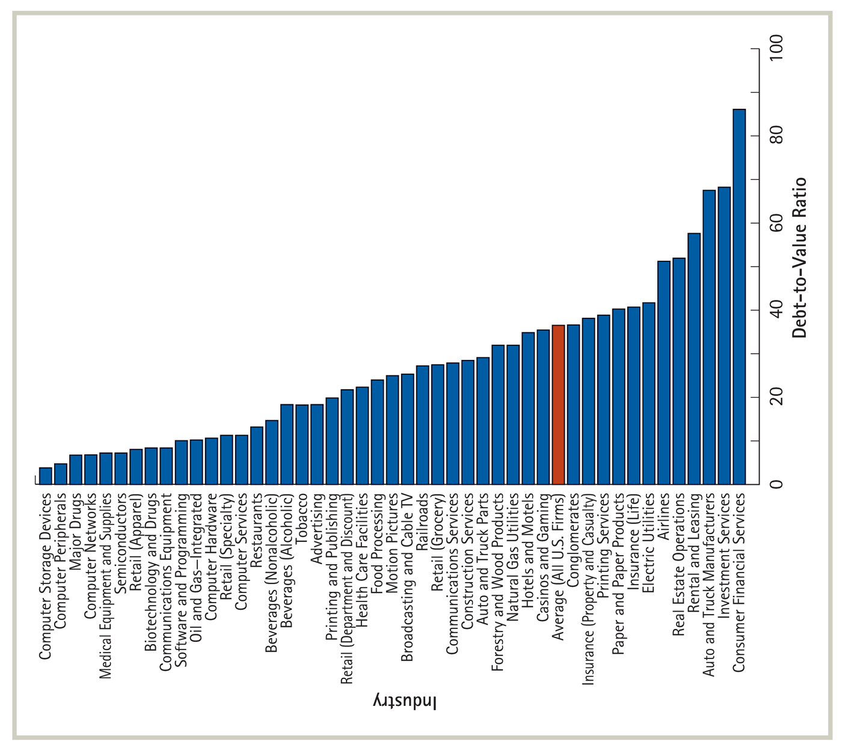
Debt-to-Value Ratio [D / (E + D)] for Select Industries

Slide 46
The Optimal Debt Level
R&D-Intensive Firms
Firms with high R&D costs and future growth opportunities typically maintain low debt levels.
These firms tend to have low current free cash flows and risky business strategies.
Low-Growth, Mature Firms
Mature, low-growth firms with stable cash flows and tangible assets often carry a high-debt load.
These firms tend to have high free cash flows with few good investment opportunities.

