Slide 1
SQL Part 3: Multiple Tables and JOIN

Slide 2
Question: Who Wrote the Paper "Hive and Hadoop"?
Paper
PaperID | PaperTitle | DomainID | PaperLength | ResearcherID
1 | Stock Predications for 2018 | 2 | 32 | 1
2 | Sox Complaints and Compliance | 3 | 39 | 2
3 | Big Clouds | 1 | 22 | 1
4 | Spark and Analytics | 3 | 20 | 3
5 | Hive and Hadoop | 3 | 22 | 3
6 | Augmented Reality in 2020 | 3 | 45 | 3
7 | Start Up Funding Best Practices | 1 | 15 | 2
8 | Visualization Dos and Donts | 3 | 31 | 1
9 | AI in Five Years | 3 | 16 | 3
10 | Depreciating IT Investments | 2 | 18 | 2
Researcher
ResearcherID | ResName | DomainID | SchoolID
1 | Dr. Hahn | 3 | 2
2 | Dr. Lee | 2 | 1
3 | Dr. Arling | 1 | 3

Slide 3
What is a Database Management System (DBMS)?
Program used to create, process, and administer a database
Licensed from vendors such as Oracle, Microsoft, IBM, …
Oracle Database from Oracle Corporation
SQL Server and Access from Microsoft
Db2 from IBM
MySQL: open source, license-free for most uses
All products above are Relational Database Management Systems (RDBMS)
Notes:
Amazon Aurora??
Pronunciation of SQL and history from http://patorjk.com/blog/2012/01/26/pronouncing-sql-s-q-l-or-sequel/
Created at IBM
MySQL (open-source): My S-Q-L
SQL Server (Microsoft): Sequel Server
Language officially S-Q-L though both pronunciations used
Changing for Big Data: NoSQL (Not Only SQL)
Trends: IoT (explosion of data); cloud-based; integrated AI; faster analytics

Slide 4
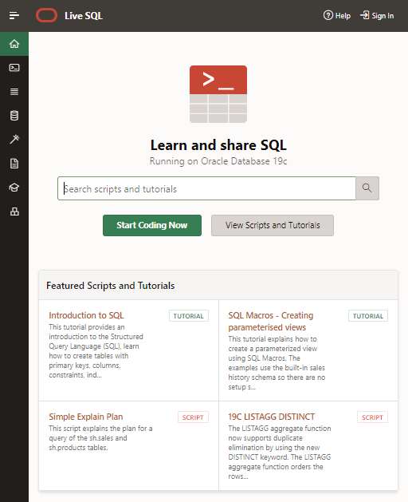
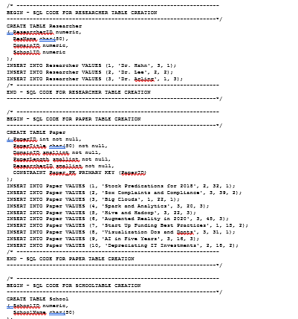
Sign Into Your Oracle Live SQL Account
Go to https://livesql.oracle.com and Sign In
Open SQL in-class 3 script.txt in D2L and copy/paste SQL code to create 3 tables

Slide 5
How To Combine Researcher Data with Paper Table?
X
Paper
PaperID | PaperTitle | DomainID | PaperLength | ResearcherID | ResearcherID | ResName | DomainID | SchoolID
1 | Stock Predications for 2018 | 2 | 32 | 1 | 1 | Dr. Hahn | 3 | 2
2 | Sox Complaints and Compliance | 3 | 39 | 2 | 2 | Dr. Lee | 2 | 1
3 | Big Clouds | 1 | 22 | 1 | 1 | Dr. Hahn | 3 | 2
4 | Spark and Analytics | 3 | 20 | 3 | 3 | Dr. Arling | 1 | 3
5 | Hive and Hadoop | 3 | 22 | 3 | 3 | Dr. Arling | 1 | 3
6 | Augmented Reality in 2020 | 3 | 45 | 3 | 3 | Dr. Arling | 1 | 3
7 | Start Up Funding Best Practices | 1 | 15 | 2 | 2 | Dr. Lee | 2 | 1
8 | Visualization Dos and Donts | 3 | 31 | 1 | 1 | Dr. Hahn | 3 | 2
9 | AI in Five Years | 3 | 16 | 3 | 3 | Dr. Arling | 1 | 3
10 | Depreciating IT Investments | 2 | 18 | 2 | 2 | Dr. Lee | 2 | 1
Researcher
Add data to Paper table?
Creates problems…
ResearcherID | ResName | DomainID | SchoolID
1 | Dr. Hahn | 3 | 2
2 | Dr. Lee | 2 | 1
3 | Dr. Arling | 1 | 3
Notes:
Just like Library example—redundant data, can’t add a Researcher until they’ve published

Slide 6
In a DB, Tables Are Linked with “Keys”
Paper
Researcher
PaperID | PaperTitle | DomainID | PaperLength | ResearcherID
1 | Stock Predications for 2018 | 2 | 32 | 1
2 | Sox Complaints and Compliance | 3 | 39 | 2
3 | Big Clouds | 1 | 22 | 1
4 | Spark and Analytics | 3 | 20 | 3
5 | Hive and Hadoop | 3 | 22 | 3
6 | Augmented Reality in 2020 | 3 | 45 | 3
7 | Start Up Funding Best Practices | 1 | 15 | 2
8 | Visualization Dos and Donts | 3 | 31 | 1
9 | AI in Five Years | 3 | 16 | 3
10 | Depreciating IT Investments | 2 | 18 | 2
ResearcherID | ResName | DomainID | SchoolID
1 | Dr. Hahn | 3 | 2
2 | Dr. Lee | 2 | 1
3 | Dr. Arling | 1 | 3
Primary Keys
Foreign Keys
Notes:
Just like Library example—redundant data, can’t add a Researcher until they’ve published (we'll use this with Tableau, too)

Slide 7
Task 1: A “Brute-Force,” “Manual” Use of Both Tables
X
What are the titles of the papers written by Dr. Arling?
Which ResearcherID is Dr. Arling?
SELECT ResearcherID FROM Researcher WHERE ResName = 'Dr. Arling';
Which papers written by researcher with ID of 3?
SELECT PaperTitle FROM Paper WHERE ResearcherID = 3;
3
Need to delimit with ' and case is important
Paper
PaperID | PaperTitle | DomainID | PaperLength | ResearcherID
1 | Stock Predications for 2018 | 2 | 32 | 1
2 | Sox Complaints and Compliance | 3 | 39 | 2
3 | Big Clouds | 1 | 22 | 1
4 | Spark and Analytics | 3 | 20 | 3
5 | Hive and Hadoop | 3 | 22 | 3
6 | Augmented Reality in 2020 | 3 | 45 | 3
7 | Start Up Funding Best Practices | 1 | 15 | 2
8 | Visualization Dos and Donts | 3 | 31 | 1
9 | AI in Five Years | 3 | 16 | 3
10 | Depreciating IT Investments | 2 | 18 | 2
Researcher
ResearcherID | ResName | DomainID | SchoolID
1 | Dr. Hahn | 3 | 2
2 | Dr. Lee | 2 | 1
3 | Dr. Arling | 1 | 3

Slide 8
Task 2: SQL and JOIN
Use “table.field” notation since there will be more than one table in the SQL statement
What are the titles of the papers written by Dr. Arling?
SELECT Paper.PaperTitle
FROM Paper JOIN Researcher
ON Paper.ResearcherID = Researcher.ResearcherID
WHERE Researcher.ResName = 'Dr. Arling';
The second table and…
…how they are linked
Paper
PaperID | PaperTitle | DomainID | PaperLength | ResearcherID
1 | Stock Predications for 2018 | 2 | 32 | 1
2 | Sox Complaints and Compliance | 3 | 39 | 2
3 | Big Clouds | 1 | 22 | 1
4 | Spark and Analytics | 3 | 20 | 3
5 | Hive and Hadoop | 3 | 22 | 3
6 | Augmented Reality in 2020 | 3 | 45 | 3
7 | Start Up Funding Best Practices | 1 | 15 | 2
8 | Visualization Dos and Donts | 3 | 31 | 1
9 | AI in Five Years | 3 | 16 | 3
10 | Depreciating IT Investments | 2 | 18 | 2
Researcher
ResearcherID | ResName | DomainID | SchoolID
1 | Dr. Hahn | 3 | 2
2 | Dr. Lee | 2 | 1
3 | Dr. Arling | 1 | 3
Notes:
Use of Table.Column is best practice; req’d if Column in multiple tables (“ambiguous” error) Show that case is important in 'Dr. Arling’
Make list

Slide 9
Task 3: SQL and JOIN
List the titles and corresponding author (Researcher)
SELECT Paper.PaperTitle, Researcher.ResName
FROM Paper JOIN Researcher
ON Paper.ResearcherID = Researcher.ResearcherID;
Paper
PaperID | PaperTitle | DomainID | PaperLength | ResearcherID
1 | Stock Predications for 2018 | 2 | 32 | 1
2 | Sox Complaints and Compliance | 3 | 39 | 2
3 | Big Clouds | 1 | 22 | 1
4 | Spark and Analytics | 3 | 20 | 3
5 | Hive and Hadoop | 3 | 22 | 3
6 | Augmented Reality in 2020 | 3 | 45 | 3
7 | Start Up Funding Best Practices | 1 | 15 | 2
8 | Visualization Dos and Donts | 3 | 31 | 1
9 | AI in Five Years | 3 | 16 | 3
10 | Depreciating IT Investments | 2 | 18 | 2
Researcher
ResearcherID | ResName | DomainID | SchoolID
1 | Dr. Hahn | 3 | 2
2 | Dr. Lee | 2 | 1
3 | Dr. Arling | 1 | 3
Notes:
Show that case is important in 'Dr. Arling’
Make list

Slide 10
Task 4: JOIN and Compound WHERE
What are the titles of the papers written by Dr. Arling that are longer than 35 pages?
SELECT Paper.PaperTitle
FROM Paper JOIN Researcher
ON Paper.ResearcherID = Researcher.ResearcherID
WHERE Researcher.ResName = 'Dr. Arling'
AND Paper.PaperLength > 35;
Use “table.field” notation since there is more than one table in the SQL statement
Paper
PaperID | PaperTitle | DomainID | PaperLength | ResearcherID
1 | Stock Predications for 2018 | 2 | 32 | 1
2 | Sox Complaints and Compliance | 3 | 39 | 2
3 | Big Clouds | 1 | 22 | 1
4 | Spark and Analytics | 3 | 20 | 3
5 | Hive and Hadoop | 3 | 22 | 3
6 | Augmented Reality in 2020 | 3 | 45 | 3
7 | Start Up Funding Best Practices | 1 | 15 | 2
8 | Visualization Dos and Donts | 3 | 31 | 1
9 | AI in Five Years | 3 | 16 | 3
10 | Depreciating IT Investments | 2 | 18 | 2
Researcher
ResearcherID | ResName | DomainID | SchoolID
1 | Dr. Hahn | 3 | 2
2 | Dr. Lee | 2 | 1
3 | Dr. Arling | 1 | 3

Slide 11
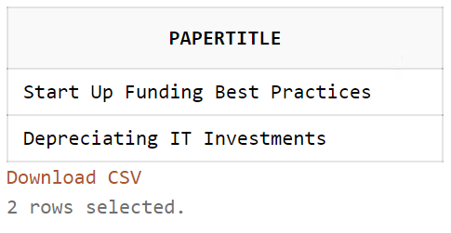
Task 5: JOIN and Compound WHERE
What are the titles of the papers written by Dr. Lee that are shorter than 20 pages?
Give it a try…
SELECT Paper.PaperTitle
FROM Paper JOIN Researcher
ON Paper.ResearcherID = Researcher.ResearcherID
WHERE Researcher.ResName = 'Dr. Lee'
AND Paper.PaperLength < 20;
Paper
PaperID | PaperTitle | DomainID | PaperLength | ResearcherID
1 | Stock Predications for 2018 | 2 | 32 | 1
2 | Sox Complaints and Compliance | 3 | 39 | 2
3 | Big Clouds | 1 | 22 | 1
4 | Spark and Analytics | 3 | 20 | 3
5 | Hive and Hadoop | 3 | 22 | 3
6 | Augmented Reality in 2020 | 3 | 45 | 3
7 | Start Up Funding Best Practices | 1 | 15 | 2
8 | Visualization Dos and Donts | 3 | 31 | 1
9 | AI in Five Years | 3 | 16 | 3
10 | Depreciating IT Investments | 2 | 18 | 2
Researcher
ResearcherID | ResName | DomainID | SchoolID
1 | Dr. Hahn | 3 | 2
2 | Dr. Lee | 2 | 1
3 | Dr. Arling | 1 | 3

Slide 12
Task 6: JOIN with Three Tables
What are the title(s) and author(s) of the papers written by Researchers from TCU?
Paper
PaperID | PaperTitle | DomainID | PaperLength | ResearcherID
1 | Stock Predications for 2018 | 2 | 32 | 1
2 | Sox Complaints and Compliance | 3 | 39 | 2
3 | Big Clouds | 1 | 22 | 1
4 | Spark and Analytics | 3 | 20 | 3
5 | Hive and Hadoop | 3 | 22 | 3
6 | Augmented Reality in 2020 | 3 | 45 | 3
7 | Start Up Funding Best Practices | 1 | 15 | 2
8 | Visualization Dos and Donts | 3 | 31 | 1
9 | AI in Five Years | 3 | 16 | 3
10 | Depreciating IT Investments | 2 | 18 | 2
Researcher
ResearcherID | ResName | DomainID | SchoolID
1 | Dr. Hahn | 3 | 2
2 | Dr. Lee | 2 | 1
3 | Dr. Arling | 1 | 3
School
Primary Keys
SchoolID | SchoolName
1 | TCU
2 | SMU
3 | UTA
Foreign Keys

Slide 13
Task 6: JOIN with Three Tables
What are the title(s) and author(s) of the papers written by Researchers from TCU?
SELECT Paper.PaperTitle, Researcher.ResName
FROM Paper JOIN Researcher
ON Paper.ResearcherID = Researcher.ResearcherID
JOIN School ON Researcher.SchoolID=School.SchoolID
WHERE School.SchoolName = 'TCU';
Researcher
Paper
ResearcherID | ResName | DomainID | SchoolID
1 | Dr. Hahn | 3 | 2
2 | Dr. Lee | 2 | 1
3 | Dr. Arling | 1 | 3
PaperID | PaperTitle | DomainID | PaperLength | ResearcherID
1 | Stock Predications for 2018 | 2 | 32 | 1
2 | Sox Complaints and Compliance | 3 | 39 | 2
3 | Big Clouds | 1 | 22 | 1
4 | Spark and Analytics | 3 | 20 | 3
5 | Hive and Hadoop | 3 | 22 | 3
6 | Augmented Reality in 2020 | 3 | 45 | 3
7 | Start Up Funding Best Practices | 1 | 15 | 2
8 | Visualization Dos and Donts | 3 | 31 | 1
9 | AI in Five Years | 3 | 16 | 3
10 | Depreciating IT Investments | 2 | 18 | 2
School
SchoolID | SchoolName
1 | TCU
2 | SMU
3 | UTA

Slide 14
Task 7: Let’s Put It All Together
What are total pages of the reports by school?
SELECT School.SchoolName, SUM(Paper.PaperLength)
FROM Paper JOIN Researcher
ON Paper.ResearcherID = Researcher.ResearcherID
JOIN School ON Researcher.SchoolID=School.SchoolID
GROUP BY School.SchoolName;
Researcher
Paper
ResearcherID | ResName | DomainID | SchoolID
1 | Dr. Hahn | 3 | 2
2 | Dr. Lee | 2 | 1
3 | Dr. Arling | 1 | 3
PaperID | PaperTitle | DomainID | PaperLength | ResearcherID
1 | Stock Predications for 2018 | 2 | 32 | 1
2 | Sox Complaints and Compliance | 3 | 39 | 2
3 | Big Clouds | 1 | 22 | 1
4 | Spark and Analytics | 3 | 20 | 3
5 | Hive and Hadoop | 3 | 22 | 3
6 | Augmented Reality in 2020 | 3 | 45 | 3
7 | Start Up Funding Best Practices | 1 | 15 | 2
8 | Visualization Dos and Donts | 3 | 31 | 1
9 | AI in Five Years | 3 | 16 | 3
10 | Depreciating IT Investments | 2 | 18 | 2
School
SchoolID | SchoolName
1 | TCU
2 | SMU
3 | UTA

Slide 15
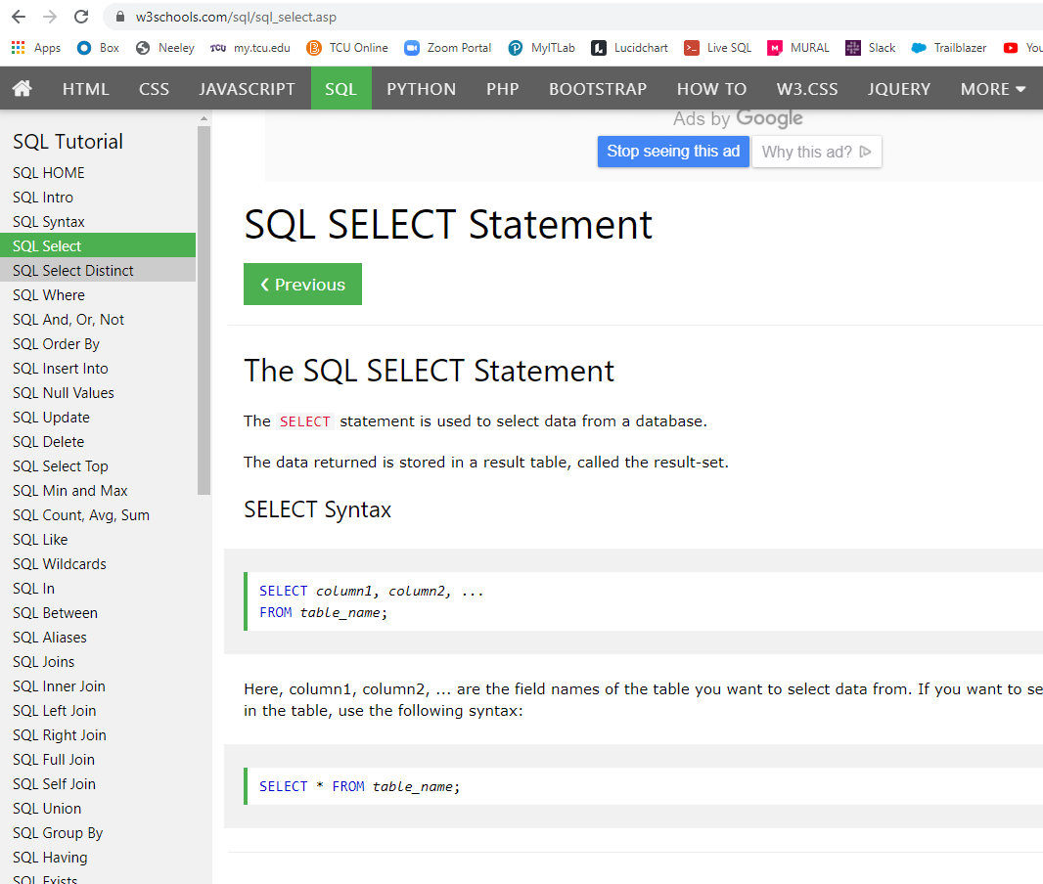
Questions about SQL?
There are many, many online resources for understanding SQL—just Google sql…
E.g., https://w3schools.com/sql
Notes:
Different types of JOIN beyond our scope: INNER JOIN (JOIN),
RIGHT JOIN, LEFT JOIN,
FULL OUTER JOIN (FULL JOIN) – note that OUTER JOIN isn’t valid syntax

