Slide 1
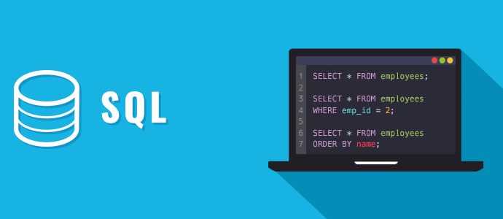
SQL Part 2: Compound WHERE and Descriptive Statistics

Slide 2
Structured vs. Unstructured Data
Structured data fits in rows and columns and includes most transactional data in business
Unstructured data does not follow a specified format and includes free-form text, audio, and video (80% of corporate data is unstructured¹)
¹InfoWorld
sherpasoftware.com
Notes:
Transactional data are structured data (generated by a transaction)

Slide 3
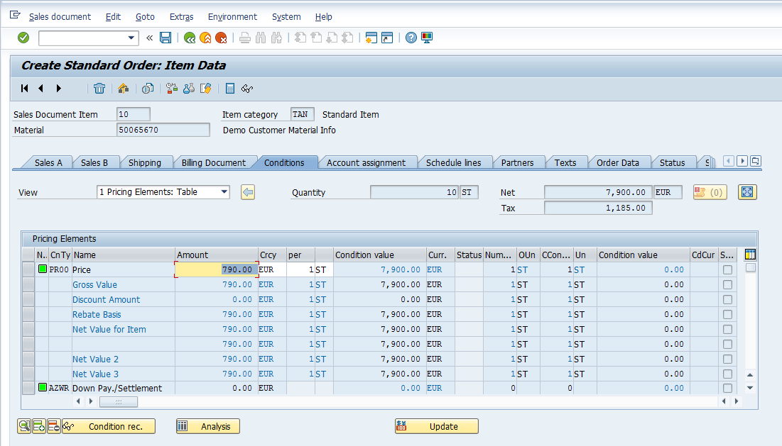
Review: Data from Transactions
Business transactions create data
Sale to a customer
B2B sales between companies
Etc.
E.g., placing an order through ERP system…
…results in data being written into an existing table in a database: structured data
OrderID | Customer | Total | Date
1 | Kroger | 30,000 | 2/25/2020
2 | Kroger | 25,000 | 2/27/2020
3 | Kroger | 22,000 | 2/28/2020
Notes:
Example: Kroger grocery store orders 200 pallets of Tostitos from Frito-Lay

Slide 4
Tables: Terminology
Table
Columns are “Fields”
Fortune_10
Rank | Company | Revenue ($M) | Revenue Change | Profit ($M) | Profit Change | Assets ($M) | Mkt Value 3/29/18 | Employees | Sector
1 | Walmart | $500,343 | 3.0% | $9,862 | -28% | $204,522 | $263,563 | 2,300,000 | Retailing
2 | Exxon Mobil | $244,363 | 17.4% | $19,710 | 151% | $348,691 | $316,157 | 71,200 | Energy
3 | Berkshire Hathaway | $242,137 | 8.3% | $44,940 | 87% | $702,095 | $492,008 | 377,000 | Financials
4 | Apple | $229,234 | 6.3% | $48,351 | 6% | $375,319 | $851,318 | 123,000 | Technology
5 | UnitedHealth Group | $201,159 | 8.8% | $10,558 | 51% | $139,058 | $207,080 | 260,000 | Health Care
6 | McKesson | $198,533 | 3.1% | $5,070 | 125% | $60,969 | $29,067 | 64,500 | Wholesalers
7 | CVS Health | $184,765 | 4.1% | $6,622 | 25% | $95,131 | $63,114 | 203,000 | Health Care
8 | Amazon | $177,866 | 30.8% | $3,033 | 28% | $131,310 | $700,668 | 566,000 | Retailing
9 | AT&T | $160,546 | -2.0% | $29,450 | 127% | $444,097 | $218,946 | 254,000 | Telecommunications
10 | General Motors | $157,311 | -5.5% | -$3,864 | -141% | $212,482 | $50,972 | 180,000 | Motor Vehicles & Parts
Rows are “Records”
“Cell”
2018 data
Notes:
Create (new row), Read, Update (cell), Delete (row);
How do we interact?

Slide 5
Tables: Terminology
Table
Columns names are “Attributes”
Rows uniquely identified by "Primary Key"
Columns are “Fields”
Fortune_10
Rank | Company | Revenue ($M) | Revenue Change | Profit ($M) | Profit Change | Assets ($M) | Mkt Value 3/29/18 | Employees | Sector
1 | Walmart | $500,343 | 3.0% | $9,862 | -28% | $204,522 | $263,563 | 2,300,000 | Retailing
2 | Exxon Mobil | $244,363 | 17.4% | $19,710 | 151% | $348,691 | $316,157 | 71,200 | Energy
3 | Berkshire Hathaway | $242,137 | 8.3% | $44,940 | 87% | $702,095 | $492,008 | 377,000 | Financials
4 | Apple | $229,234 | 6.3% | $48,351 | 6% | $375,319 | $851,318 | 123,000 | Technology
5 | UnitedHealth Group | $201,159 | 8.8% | $10,558 | 51% | $139,058 | $207,080 | 260,000 | Health Care
6 | McKesson | $198,533 | 3.1% | $5,070 | 125% | $60,969 | $29,067 | 64,500 | Wholesalers
7 | CVS Health | $184,765 | 4.1% | $6,622 | 25% | $95,131 | $63,114 | 203,000 | Health Care
8 | Amazon | $177,866 | 30.8% | $3,033 | 28% | $131,310 | $700,668 | 566,000 | Retailing
9 | AT&T | $160,546 | -2.0% | $29,450 | 127% | $444,097 | $218,946 | 254,000 | Telecommunications
10 | General Motors | $157,311 | -5.5% | -$3,864 | -141% | $212,482 | $50,972 | 180,000 | Motor Vehicles & Parts
Rows are “Records”
“Cell”
2018 data
Notes:
Create (new row), Read, Update (cell), Delete (row);
How do we interact?

Slide 6
Working with Data: Structured Query Language (SQL)
SQL is standards-based, declarative language for accessing and manipulating a database
Create
Read
Update
Delete
Notes:
Note: we’ll start by working with one table at a time (DB have multiple, connected tables)

Slide 7
Today’s In-Class Exercise
Learning objectives:
Use SELECT WHERE with multiple conditions (AND, OR, NOT)
Calculate statistics within SQL for entire table or selected records (AVG, SUM, MAX, …)
Same scenario as last class
You are an analyst for an investment bank that is considering acquiring a boutique consulting firm that performs research on technology, start ups, and investments. Prior to the acquisition decision, you need to perform due diligence—is there value in this investment?
You have been provided two tables with data
Researcher table about their employees (the researchers) and
Paper table about their work (only one we’ll use today)
You need to pull data from these database tables to perform your analysis

Slide 8
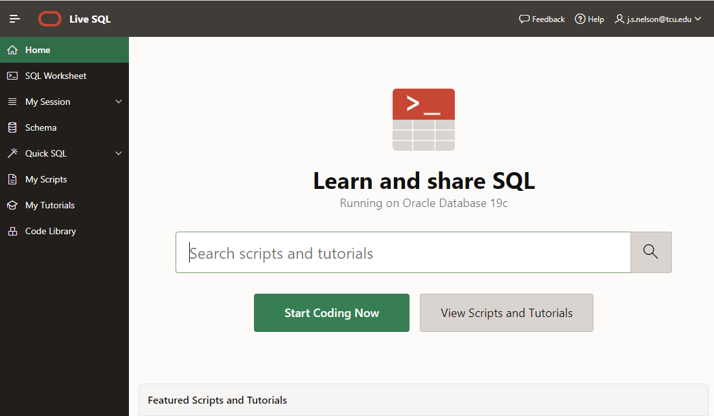
Oracle Live SQL: https://livesql.oracle.com
Enter SQL Commands
View SQL Command History
Your userid: include in all homework screenshots!
View Tables

Slide 9
Create Paper Table in Live SQL
/* --------------------------------------------------------------
BEGIN - SQL CODE FOR PAPER TABLE CREATION
----------------------------------------------------------------*/
CREATE TABLE Paper
( PaperID int not null,
PaperTitle char(50) not null,
DomainID smallint not null,
PaperLength smallint not null,
ResearcherID smallint not null,
PRIMARY KEY (PaperID)
);
INSERT INTO Paper VALUES (1, 'Stock Predications for 2018', 2, 32, 1);
INSERT INTO Paper VALUES (2, 'Sox Complaints and Compliance', 3, 39, 2);
INSERT INTO Paper VALUES (3, 'Big Clouds', 1, 40, 1);
INSERT INTO Paper VALUES (4, 'Spark and Analytics', 3, 20, 3);
INSERT INTO Paper VALUES (5, 'Hive and Hadoop', 3, 22, 3);
INSERT INTO Paper VALUES (6, 'Augmented Reality in 2020', 3, 45, 3);
INSERT INTO Paper VALUES (7, 'Start Up Funding Best Practices', 1, 15, 2);
INSERT INTO Paper VALUES (8, 'Visualization Dos and Donts', 3, 31, 1);
INSERT INTO Paper VALUES (9, 'AI in Five Years', 3, 16, 3);
INSERT INTO Paper VALUES (10, 'Depreciating IT Investments', 2, 18, 2);
/* --------------------------------------------------------------
END - SQL CODE FOR PAPER TABLE CREATION
----------------------------------------------------------------*/
Open SQL in-class 2 script.txt on D2L to copy/paste the SQL code needed to create the two tables:
Cntl-a, Cntl-c and then paste with Cntl-v
Paper
PaperID | PaperTitle | DomainID | PaperLength | ResearcherID
1 | Stock Predications for 2018 | 2 | 32 | 1
2 | Sox Complaints and Compliance | 3 | 39 | 2
3 | Big Clouds | 1 | 40 | 1
4 | Spark and Analytics | 3 | 20 | 3
5 | Hive and Hadoop | 3 | 22 | 3
6 | Augmented Reality in 2020 | 3 | 45 | 3
7 | Start Up Funding Best Practices | 1 | 15 | 2
8 | Visualization Dos and Donts | 3 | 31 | 1
9 | AI in Five Years | 3 | 16 | 3
10 | Depreciating IT Investments | 2 | 18 | 2

Slide 10
Task 0 (Review)
Retrieve the paper title(s) where the paper length is more than 35
SELECT PaperTitle FROM Paper WHERE PaperLength > 35;
Paper
PaperLength > 35
PaperID | PaperTitle | DomainID | PaperLength | ResearcherID
1 | Stock Predications for 2018 | 2 | 32 | 1
2 | Sox Complaints and Compliance | 3 | 39 | 2
3 | Big Clouds | 1 | 40 | 1
4 | Spark and Analytics | 3 | 20 | 3
5 | Hive and Hadoop | 3 | 22 | 3
6 | Augmented Reality in 2020 | 3 | 45 | 3
7 | Start Up Funding Best Practices | 1 | 15 | 2
8 | Visualization Dos and Donts | 3 | 31 | 1
9 | AI in Five Years | 3 | 16 | 3
10 | Depreciating IT Investments | 2 | 18 | 2

Slide 11
Task 1: SQL Compound WHERE Clause
Retrieve the paper title(s) where the paper length is more than 35 and the researcher ID is 3
SELECT PaperTitle FROM Paper WHERE PaperLength > 35 AND ResearcherID = 3;
Paper
PaperLength > 35
ResearcherID = 3
PaperID | PaperTitle | DomainID | PaperLength | ResearcherID
1 | Stock Predications for 2018 | 2 | 32 | 1
2 | Sox Complaints and Compliance | 3 | 39 | 2
3 | Big Clouds | 1 | 40 | 1
4 | Spark and Analytics | 3 | 20 | 3
5 | Hive and Hadoop | 3 | 22 | 3
6 | Augmented Reality in 2020 | 3 | 45 | 3
7 | Start Up Funding Best Practices | 1 | 15 | 2
8 | Visualization Dos and Donts | 3 | 31 | 1
9 | AI in Five Years | 3 | 16 | 3
10 | Depreciating IT Investments | 2 | 18 | 2

Slide 12
Task 2: SQL Compound WHERE Clause
Retrieve the paper title(s) where the paper length is more than 35 or the researcher ID is 3
SELECT PaperTitle FROM Paper WHERE PaperLength > 35 OR ResearcherID = 3;
Paper
PaperLength > 35
ResearcherID = 3
PaperID | PaperTitle | DomainID | PaperLength | ResearcherID
1 | Stock Predications for 2018 | 2 | 32 | 1
2 | Sox Complaints and Compliance | 3 | 39 | 2
3 | Big Clouds | 1 | 40 | 1
4 | Spark and Analytics | 3 | 20 | 3
5 | Hive and Hadoop | 3 | 22 | 3
6 | Augmented Reality in 2020 | 3 | 45 | 3
7 | Start Up Funding Best Practices | 1 | 15 | 2
8 | Visualization Dos and Donts | 3 | 31 | 1
9 | AI in Five Years | 3 | 16 | 3
10 | Depreciating IT Investments | 2 | 18 | 2

Slide 13
Write the SQL to Obtain the Following…
Retrieve the paper title(s) in each of the following three cases:
The domain ID is 1 and the paper length is less than 32 pages
The domain ID is 1 or 3 and the paper length is less than 32 pages
The domain ID is 1, 2, or 3 and the paper length is more than 20 pages and less than 32 pages
PaperID | PaperTitle | DomainID | PaperLength | ResearcherID
1 | Stock Predications for 2018 | 2 | 32 | 1
2 | Sox Complaints and Compliance | 3 | 39 | 2
3 | Big Clouds | 1 | 40 | 1
4 | Spark and Analytics | 3 | 20 | 3
5 | Hive and Hadoop | 3 | 22 | 3
6 | Augmented Reality in 2020 | 3 | 45 | 3
7 | Start Up Funding Best Practices | 1 | 15 | 2
8 | Visualization Dos and Donts | 3 | 31 | 1
9 | AI in Five Years | 3 | 16 | 3
10 | Depreciating IT Investments | 2 | 18 | 2
Paper
Notes:
For 2, should get 5 results but get 6 if parentheses are incorrectly omitted

Slide 14
Solution to Number 1
Retrieve the paper title(s) in each of the following three cases:
The domain ID is 1 and the paper length is less than 32 pages
SELECT PaperTitle FROM Paper WHERE DomainID = 1 AND PaperLength < 32;
PaperID | PaperTitle | DomainID | PaperLength | ResearcherID
1 | Stock Predications for 2018 | 2 | 32 | 1
2 | Sox Complaints and Compliance | 3 | 39 | 2
3 | Big Clouds | 1 | 40 | 1
4 | Spark and Analytics | 3 | 20 | 3
5 | Hive and Hadoop | 3 | 22 | 3
6 | Augmented Reality in 2020 | 3 | 45 | 3
7 | Start Up Funding Best Practices | 1 | 15 | 2
8 | Visualization Dos and Donts | 3 | 31 | 1
9 | AI in Five Years | 3 | 16 | 3
10 | Depreciating IT Investments | 2 | 18 | 2
Paper
Notes:
5 not 6

Slide 15
Solution to Number 2: Need for Parentheses
…the domain ID is 1 or 3 and the paper length is less than 32 pages; how many selected?
SELECT PaperTitle FROM Paper WHERE (DomainID = 1 OR DomainID = 3) AND PaperLength < 32;
5
Note: AND is done first and then OR so without parentheses would behave incorrectly:
WHERE DomainID = 1 OR (DomainID = 3 AND PaperLength < 32);
PaperID | PaperTitle | DomainID | PaperLength | ResearcherID
1 | Stock Predications for 2018 | 2 | 32 | 1
2 | Sox Complaints and Compliance | 3 | 39 | 2
3 | Big Clouds | 1 | 40 | 1
4 | Spark and Analytics | 3 | 20 | 3
5 | Hive and Hadoop | 3 | 22 | 3
6 | Augmented Reality in 2020 | 3 | 45 | 3
7 | Start Up Funding Best Practices | 1 | 15 | 2
8 | Visualization Dos and Donts | 3 | 31 | 1
9 | AI in Five Years | 3 | 16 | 3
10 | Depreciating IT Investments | 2 | 18 | 2
Without parentheses “Big Clouds” would be incorrectly selected
Paper
Notes:
5 not 6

Slide 16
Solution to Number 3: Parentheses Needed
…the domain ID is 1, 2, or 3 and the paper length is more than 20 pages and less than 32 pages; how many selected?
SELECT PaperTitle FROM Paper WHERE (DomainID = 1 OR DomainID = 2 OR DomainID = 3) AND PaperLength > 20 AND PaperLength < 32;
2
PaperID | PaperTitle | DomainID | PaperLength | ResearcherID
1 | Stock Predications for 2018 | 2 | 32 | 1
2 | Sox Complaints and Compliance | 3 | 39 | 2
3 | Big Clouds | 1 | 40 | 1
4 | Spark and Analytics | 3 | 20 | 3
5 | Hive and Hadoop | 3 | 22 | 3
6 | Augmented Reality in 2020 | 3 | 45 | 3
7 | Start Up Funding Best Practices | 1 | 15 | 2
8 | Visualization Dos and Donts | 3 | 31 | 1
9 | AI in Five Years | 3 | 16 | 3
10 | Depreciating IT Investments | 2 | 18 | 2
Paper
Notes:
Note that BETWEEN keyword would be 20 <= PaperLength <= 32 and give wrong answer

Slide 17
SQL and Descriptive Statistics
We can use SQL to return summarized data, too
For example, how many papers are there? COUNT()
SELECT COUNT(PaperTitle) FROM Paper;
What is the average length of all papers? AVG()
SELECT AVG(PaperLength) FROM Paper;
10
27.8
PaperID | PaperTitle | DomainID | PaperLength | ResearcherID
1 | Stock Predications for 2018 | 2 | 32 | 1
2 | Sox Complaints and Compliance | 3 | 39 | 2
3 | Big Clouds | 1 | 40 | 1
4 | Spark and Analytics | 3 | 20 | 3
5 | Hive and Hadoop | 3 | 22 | 3
6 | Augmented Reality in 2020 | 3 | 45 | 3
7 | Start Up Funding Best Practices | 1 | 15 | 2
8 | Visualization Dos and Donts | 3 | 31 | 1
9 | AI in Five Years | 3 | 16 | 3
10 | Depreciating IT Investments | 2 | 18 | 2
Paper

Slide 18
Task 4: Descriptive Statistics with WHERE
What is the average length of the papers for all papers longer than 18 pages?
SELECT AVG(PaperLength) FROM Paper WHERE PaperLength > 18;
32.7
Paper
PaperID | PaperTitle | DomainID | PaperLength | ResearcherID
1 | Stock Predications for 2018 | 2 | 32 | 1
2 | Sox Complaints and Compliance | 3 | 39 | 2
3 | Big Clouds | 1 | 40 | 1
4 | Spark and Analytics | 3 | 20 | 3
5 | Hive and Hadoop | 3 | 22 | 3
6 | Augmented Reality in 2020 | 3 | 45 | 3
7 | Start Up Funding Best Practices | 1 | 15 | 2
8 | Visualization Dos and Donts | 3 | 31 | 1
9 | AI in Five Years | 3 | 16 | 3
10 | Depreciating IT Investments | 2 | 18 | 2

Slide 19
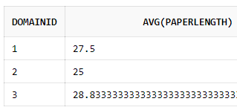
Task 5: GROUP BY
What is the average length of the papers for all papers belonging to Domain 1?
SELECT AVG(PaperLength) FROM Paper WHERE DomainID = 1;
What is average length for each of the domains (1, 2, and 3)?
SELECT AVG(PaperLength) FROM Paper GROUP BY DomainID;
Which is which?
SELECT DomainID, AVG(PaperLength) FROM Paper GROUP BY DomainID;
27.5
27.5, 25, 28.8
PaperID | PaperTitle | DomainID | PaperLength | ResearcherID
1 | Stock Predications for 2018 | 2 | 32 | 1
2 | Sox Complaints and Compliance | 3 | 39 | 2
3 | Big Clouds | 1 | 40 | 1
4 | Spark and Analytics | 3 | 20 | 3
5 | Hive and Hadoop | 3 | 22 | 3
6 | Augmented Reality in 2020 | 3 | 45 | 3
7 | Start Up Funding Best Practices | 1 | 15 | 2
8 | Visualization Dos and Donts | 3 | 31 | 1
9 | AI in Five Years | 3 | 16 | 3
10 | Depreciating IT Investments | 2 | 18 | 2
Paper

Slide 20
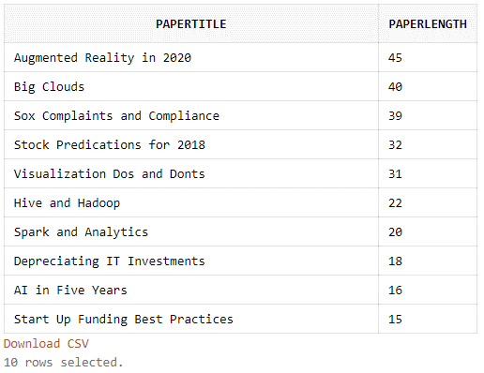
Task 6: ORDER BY
Show all titles and paper length ordered from longest to shortest.
SELECT PaperTitle, PaperLength FROM Paper
ORDER BY PaperLength DESC;
Paper
PaperID | PaperTitle | DomainID | PaperLength | ResearcherID
1 | Stock Predications for 2018 | 2 | 32 | 1
2 | Sox Complaints and Compliance | 3 | 39 | 2
3 | Big Clouds | 1 | 40 | 1
4 | Spark and Analytics | 3 | 20 | 3
5 | Hive and Hadoop | 3 | 22 | 3
6 | Augmented Reality in 2020 | 3 | 45 | 3
7 | Start Up Funding Best Practices | 1 | 15 | 2
8 | Visualization Dos and Donts | 3 | 31 | 1
9 | AI in Five Years | 3 | 16 | 3
10 | Depreciating IT Investments | 2 | 18 | 2

Slide 21
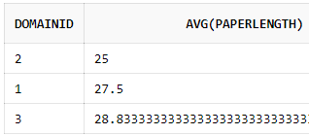
Task 7: GROUP BY and ORDER BY
What is average paper length for each domains (1, 2, and 3) ordered by paper length?
SELECT DomainID, AVG(PaperLength)
FROM Paper
GROUP BY DomainID
ORDER BY AVG(PaperLength);
Paper
PaperID | PaperTitle | DomainID | PaperLength | ResearcherID
1 | Stock Predications for 2018 | 2 | 32 | 1
2 | Sox Complaints and Compliance | 3 | 39 | 2
3 | Big Clouds | 1 | 40 | 1
4 | Spark and Analytics | 3 | 20 | 3
5 | Hive and Hadoop | 3 | 22 | 3
6 | Augmented Reality in 2020 | 3 | 45 | 3
7 | Start Up Funding Best Practices | 1 | 15 | 2
8 | Visualization Dos and Donts | 3 | 31 | 1
9 | AI in Five Years | 3 | 16 | 3
10 | Depreciating IT Investments | 2 | 18 | 2
Notes:
Change data so ORDER BY AVG(PaperLength) is different; add ORDER BY without GROUP BY example

Slide 22
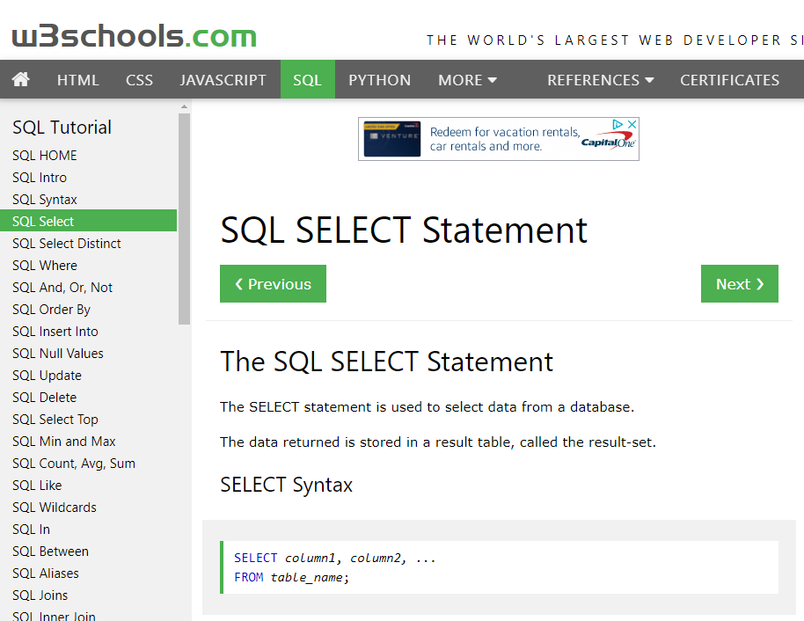
Questions about SQL?
There are many, many online resources for understanding SQL—just Google sql…
E.g., https://w3schools.com/sql

