Slide 1
Digital Transformation: Business Intelligence and SQL
InfoWorld (Data Lake)

Slide 2
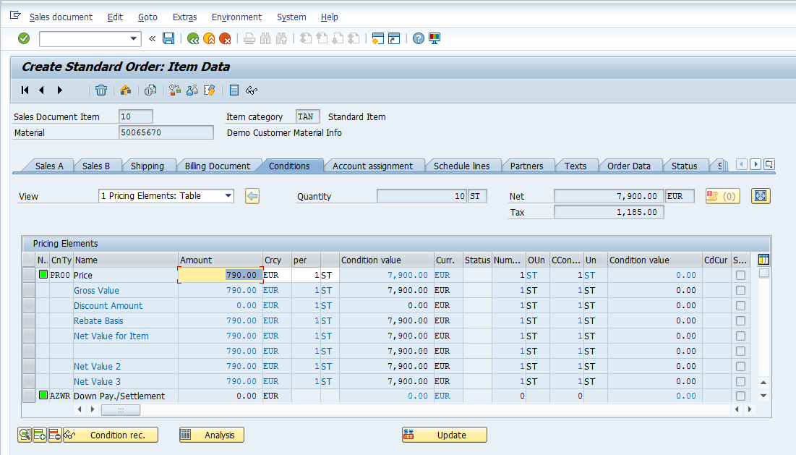
Data from Transactions
Business transactions create data
A sale to a customer
B2B sale between companies
Etc.
E.g., placing an order through ERP system…
…results in data being written into an existing table in a database
OrderID | Customer | Total | Date
1 | Kroger | 30,000 | 2/25/2020
2 | Kroger | 25,000 | 2/27/2020
3 | Kroger | 22,000 | 2/28/2020
Notes:
Example: Kroger grocery store orders 200 pallets of Tostitos from Frito-Lay

Slide 3
Tables: Terminology
Table
Columns are “Fields”
Fortune_10
Rank | Company | Revenue ($M) | Revenue Change | Profit ($M) | Profit Change | Assets ($M) | Mkt Value 3/29/18 | Employees | Sector
1 | Walmart | $500,343 | 3.0% | $9,862 | -28% | $204,522 | $263,563 | 2,300,000 | Retailing
2 | Exxon Mobil | $244,363 | 17.4% | $19,710 | 151% | $348,691 | $316,157 | 71,200 | Energy
3 | Berkshire Hathaway | $242,137 | 8.3% | $44,940 | 87% | $702,095 | $492,008 | 377,000 | Financials
4 | Apple | $229,234 | 6.3% | $48,351 | 6% | $375,319 | $851,318 | 123,000 | Technology
5 | UnitedHealth Group | $201,159 | 8.8% | $10,558 | 51% | $139,058 | $207,080 | 260,000 | Health Care
6 | McKesson | $198,533 | 3.1% | $5,070 | 125% | $60,969 | $29,067 | 64,500 | Wholesalers
7 | CVS Health | $184,765 | 4.1% | $6,622 | 25% | $95,131 | $63,114 | 203,000 | Health Care
8 | Amazon | $177,866 | 30.8% | $3,033 | 28% | $131,310 | $700,668 | 566,000 | Retailing
9 | AT&T | $160,546 | -2.0% | $29,450 | 127% | $444,097 | $218,946 | 254,000 | Telecommunications
10 | General Motors | $157,311 | -5.5% | -$3,864 | -141% | $212,482 | $50,972 | 180,000 | Motor Vehicles & Parts
Rows are “Records”
“Cell”
2018 data
Notes:
Create (new row), Read, Update (cell), Delete (row);
How do we interact?

Slide 4
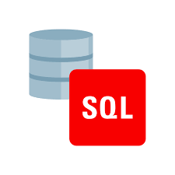
Working with Data: Structured Query Language (SQL)
SQL is standards-based, declarative language for accessing and manipulating a database and its tables
Notes:
Note: we’ll start by working with one table at a time (DB have multiple, connected tables)

Slide 5
An Example of SQL
For example, display companies from Fortune Top Ten that are in the Retailing sector
SQL command: SELECT Company FROM Fortune_10 WHERE Sector = 'Retailing';
Fortune_10
Rank | Company | Revenue ($M) | Revenue Change | Profit ($M) | Profit Change | Assets ($M) | Mkt Value 3/29/18 | Employees | Sector
1 | Walmart | $500,343 | 3.0% | $9,862 | -28% | $204,522 | $263,563 | 2,300,000 | Retailing
2 | Exxon Mobil | $244,363 | 17.4% | $19,710 | 151% | $348,691 | $316,157 | 71,200 | Energy
3 | Berkshire Hathaway | $242,137 | 8.3% | $44,940 | 87% | $702,095 | $492,008 | 377,000 | Financials
4 | Apple | $229,234 | 6.3% | $48,351 | 6% | $375,319 | $851,318 | 123,000 | Technology
5 | UnitedHealth Group | $201,159 | 8.8% | $10,558 | 51% | $139,058 | $207,080 | 260,000 | Health Care
6 | McKesson | $198,533 | 3.1% | $5,070 | 125% | $60,969 | $29,067 | 64,500 | Wholesalers
7 | CVS Health | $184,765 | 4.1% | $6,622 | 25% | $95,131 | $63,114 | 203,000 | Health Care
8 | Amazon | $177,866 | 30.8% | $3,033 | 28% | $131,310 | $700,668 | 566,000 | Retailing
9 | AT&T | $160,546 | -2.0% | $29,450 | 127% | $444,097 | $218,946 | 254,000 | Telecommunications
10 | General Motors | $157,311 | -5.5% | -$3,864 | -141% | $212,482 | $50,972 | 180,000 | Motor Vehicles & Parts
Notes:
Note: we’ll start by working with one table at a time (DB have multiple, connected tables)

Slide 6
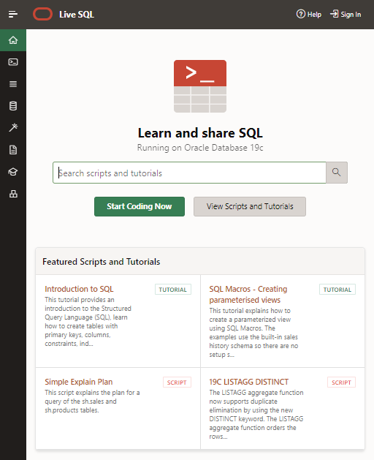
Sign Into Your Oracle Live SQL Account
Go to https://livesql.oracle.com and Sign In
Note: you need a free Oracle Live SQL account to complete these in-class exercises, homework, and Exam 2; to create
Follow the link https://livesql.oracle.com
Click Sign In in upper-right corner
Click Create Account at bottom
Complete form and click Create Account
Note: you need to reply to an email you will receive asking you to verify your account

Slide 7
Today’s In-Class Exercise
Learning objective: use SELECT command with a single table
Scenario
You are an analyst for an investment bank that is considering acquiring a boutique consulting firm that performs research on technology, start ups, and investments. Prior to the acquisition decision, you need to perform due diligence—is there value in this investment?
You have been provided two tables with data
Researcher table about their employees (the researchers) and
Paper table about the employees’ work (only one we’ll use today)
You need to “pull” data from these database tables to perform your analysis

Slide 8
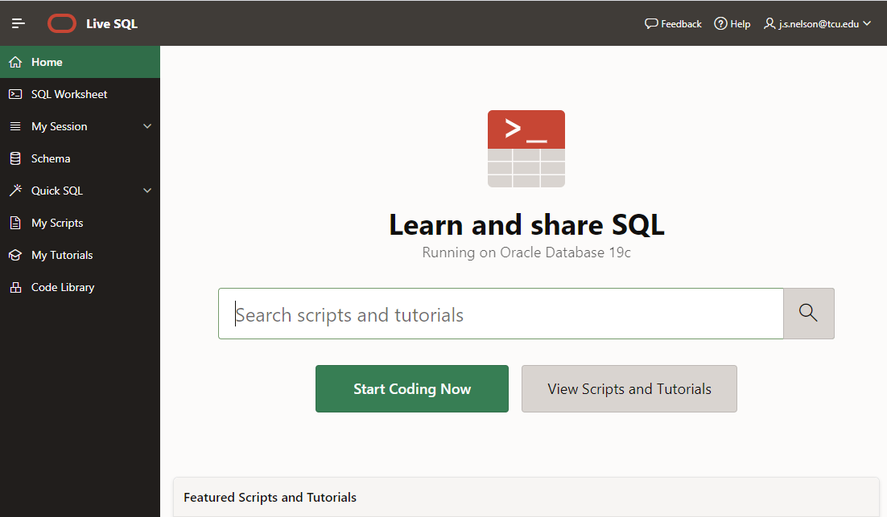
Oracle Live SQL
Enter SQL Commands
View SQL Command History
Your userid: include in all homework screenshots!
View Tables

Slide 9
Create Paper Table in Live SQL
/* --------------------------------------------------------------
BEGIN - SQL CODE FOR PAPER TABLE CREATION
----------------------------------------------------------------*/
CREATE TABLE Paper
( PaperID int not null,
PaperTitle char(50) not null,
DomainID smallint not null,
PaperLength smallint not null,
ResearcherID smallint not null,
CONSTRAINT Paper_PK PRIMARY KEY (PaperID)
);
INSERT INTO Paper VALUES (1, 'Stock Predications for 2018', 2, 32, 1);
INSERT INTO Paper VALUES (2, 'Sox Complaints and Compliance', 3, 39, 2);
INSERT INTO Paper VALUES (3, 'Big Clouds', 1, 22, 1);
INSERT INTO Paper VALUES (4, 'Spark and Analytics', 3, 20, 3);
INSERT INTO Paper VALUES (5, 'Hive and Hadoop', 3, 22, 3);
INSERT INTO Paper VALUES (6, 'Augmented Reality in 2020', 3, 45, 3);
INSERT INTO Paper VALUES (7, 'Start Up Funding Best Practices', 1, 15, 2);
INSERT INTO Paper VALUES (8, 'Visualization Dos and Donts', 3, 31, 1);
INSERT INTO Paper VALUES (9, 'AI in Five Years', 3, 16, 3);
INSERT INTO Paper VALUES (10, 'Depreciating IT Investments', 2, 18, 2);
/* --------------------------------------------------------------
END - SQL CODE FOR PAPER TABLE CREATION
----------------------------------------------------------------*/
Define table with attributes
Open SQL in-class 1 script.txt on D2L to copy/paste the SQL code needed to create the two tables:
Cntl-a, Cntl-c and then paste with Cntl-v
Put data into the cells
Paper
PaperID | PaperTitle | DomainID | PaperLength | ResearcherID
1 | Stock Predications for 2018 | 2 | 32 | 1
2 | Sox Complaints and Compliance | 3 | 39 | 2
3 | Big Clouds | 1 | 22 | 1
4 | Spark and Analytics | 3 | 20 | 3
5 | Hive and Hadoop | 3 | 22 | 3
6 | Augmented Reality in 2020 | 3 | 45 | 3
7 | Start Up Funding Best Practices | 1 | 15 | 2
8 | Visualization Dos and Donts | 3 | 31 | 1
9 | AI in Five Years | 3 | 16 | 3
10 | Depreciating IT Investments | 2 | 18 | 2

Slide 10
Task 1: SQL SELECT Statement
Display the lengths of the articles
SELECT PaperLength FROM Paper;
Display the paper title and length
SELECT PaperTitle, PaperLength FROM Paper;
Paper
PaperID | PaperTitle | DomainID | PaperLength | ResearcherID
1 | Stock Predications for 2018 | 2 | 32 | 1
2 | Sox Complaints and Compliance | 3 | 39 | 2
3 | Big Clouds | 1 | 22 | 1
4 | Spark and Analytics | 3 | 20 | 3
5 | Hive and Hadoop | 3 | 22 | 3
6 | Augmented Reality in 2020 | 3 | 45 | 3
7 | Start Up Funding Best Practices | 1 | 15 | 2
8 | Visualization Dos and Donts | 3 | 31 | 1
9 | AI in Five Years | 3 | 16 | 3
10 | Depreciating IT Investments | 2 | 18 | 2

Slide 11
Task 2: SQL SELECT Statement
Display all fields (columns) of the entire Paper table
SELECT PaperID, PaperTitle, DomainID, PaperLength, ResearcherID FROM Paper;
SELECT * FROM Paper;
Paper
PaperID | PaperTitle | DomainID | PaperLength | ResearcherID
1 | Stock Predications for 2018 | 2 | 32 | 1
2 | Sox Complaints and Compliance | 3 | 39 | 2
3 | Big Clouds | 1 | 22 | 1
4 | Spark and Analytics | 3 | 20 | 3
5 | Hive and Hadoop | 3 | 22 | 3
6 | Augmented Reality in 2020 | 3 | 45 | 3
7 | Start Up Funding Best Practices | 1 | 15 | 2
8 | Visualization Dos and Donts | 3 | 31 | 1
9 | AI in Five Years | 3 | 16 | 3
10 | Depreciating IT Investments | 2 | 18 | 2

Slide 12
Task 3: SQL WHERE Clause
Show titles for papers with more than 35 pages
SELECT PaperTitle FROM Paper WHERE PaperLength > 35;
Paper
PaperID | PaperTitle | DomainID | PaperLength | ResearcherID
1 | Stock Predications for 2018 | 2 | 32 | 1
2 | Sox Complaints and Compliance | 3 | 39 | 2
3 | Big Clouds | 1 | 22 | 1
4 | Spark and Analytics | 3 | 20 | 3
5 | Hive and Hadoop | 3 | 22 | 3
6 | Augmented Reality in 2020 | 3 | 45 | 3
7 | Start Up Funding Best Practices | 1 | 15 | 2
8 | Visualization Dos and Donts | 3 | 31 | 1
9 | AI in Five Years | 3 | 16 | 3
10 | Depreciating IT Investments | 2 | 18 | 2

Slide 13
Task 4: SQL WHERE Clause
Show the paper ID for any papers written by the researcher with ID of 2
SELECT PaperID FROM Paper WHERE ResearcherID = 2;
Paper
PaperID | PaperTitle | DomainID | PaperLength | ResearcherID
1 | Stock Predications for 2018 | 2 | 32 | 1
2 | Sox Complaints and Compliance | 3 | 39 | 2
3 | Big Clouds | 1 | 22 | 1
4 | Spark and Analytics | 3 | 20 | 3
5 | Hive and Hadoop | 3 | 22 | 3
6 | Augmented Reality in 2020 | 3 | 45 | 3
7 | Start Up Funding Best Practices | 1 | 15 | 2
8 | Visualization Dos and Donts | 3 | 31 | 1
9 | AI in Five Years | 3 | 16 | 3
10 | Depreciating IT Investments | 2 | 18 | 2

Slide 14
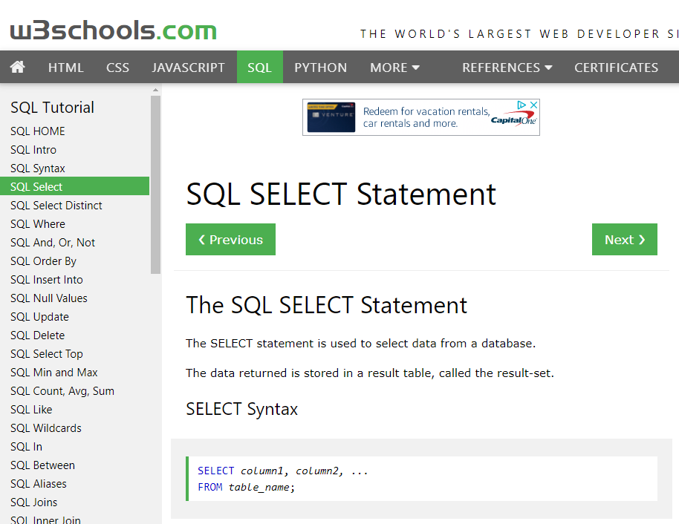
Questions about SQL?
There are many, many online resources for understanding SQL—just Google sql…
E.g., https://w3schools.com/sql

